Slide 1



FY26 Seaman to Admiral-21 (STA-21)
Mr. David Burmeister
Head, Selection and Placement
NROTC/STA-21
Comm: (847)688-5454x119
DSN: 792-5454x119
Mr. Jim Branch
STA-21 Selections
Comm: (847)688-5454x242
DSN: 792-5454x242
Ms. Twana Williams
STA-21 Selections
Comm: (847) 688-5454x243
DSN: 792-5454x243
Email: GRLK_STA21@us.navy.mil

Slide 2

STA-21 Description
Selectees attend college full-time, year round, at a NROTC-affiliated University.
Strictly Undergrad, no way to pursue graduate studies in STA-21.
Selectees are provided a maximum of up to 36 months to complete a 4yr baccalaureate degree.
Upon degree completion, selectees will become commissioned officers.
Selectees receive full pay/benefits and remain eligible for enlisted advancement while in college. The time spent in the STA-21 program does not count toward retirement, but does count toward time in service for pay purposes.
Selectees receive up to $10k annually (paid directly to the university) for tuition, books, and fees.
2

Slide 3
Disclaimer
**This brief is a generalization of the program. All applicants to this program must be familiar with the official directives related to STA-21.
**The FY26 STA-21 Program Announcement NAVADMIN Draft is in the routing chain. All details outlined in this brief are subject to change based upon NAVADMIN final approval by Chief of Naval Personnel.
**Roughly 25% of the selection packages we receive are found to be unqualified for the program for various reasons.
3

Slide 4
STA-21 Directives
OPNAV 1420.1 series (Chapter 8) is currently under revision. The STA-21 program changes annually and the STA-21 website and NAVADMIN have the most up-to-date information.
The Program Authorization (PA) for each community, which provide requirements for eligibility, can be found on the STA-21 website.
The STA-21 Announcement NAVADMIN is released annually via Naval Message and is also posted on the STA-21 website. This is where you can find what communities are open for that year.
The STA-21 website: https://www.netc.navy.mil/Commands/Naval-Service-Training-Command/STA-21/
***In the event of a conflict between any of the directives above, please call the STA-21 office for clarification. (847) 688-5454x243/242, DSN: 792-5454x243/242 ***
4

Slide 5
STA-21 Eligibility
U.S. citizen. No waivers.
Recommended by CO.
Active duty member of the Navy or Naval Reserve.
  Including FTS, National Call to Service, and SELRES* (*SELRES Must be on active duty throughout the entire application and board process through selection, and will be required to Re-enlist into Active Duty for six years upon selection notification).
High School Grad/GED complete.
Able to complete college degree in 36 months or less.
Able to commission prior to 31st birthday for Nuclear Option.
  Age requirements for STA-21 commissioning target options differ. Read the authorization guidance for the specific commissioning program.
Maintain a cumulative GPA of 2.5 on a 4.0 scale while enrolled.
  Nuclear requires 3.0 on a 4.0 scale.
  IP requires 3.0 on a 4.0 scale.
  CEC requires 2.7 on a 4.0 scale.
Must be physically qualified and have passed the previous PRT with a grade of GOOD LOW or better.

Slide 6
STA-21 Eligibility - (Continued)
SAT: Evidence-based Reading and Writing (EBRW)-500/Math-500 or ACT: English-20/Math-21.
  If applicant is unable to complete an exam due to an overseas assignment or deployment, applicants may still submit with a command letter, signed by the Commanding Officer, indicating the reason for non-availability.
  Applicants without test scores who are eligible for exemption, must ensure their high school cumulative GPA is 2.5 or better on a 4.0 scale and graduation is within the last 5 years OR a cumulative college GPA of 2.5 or better on a 4.0 scale with a minimum of 12 credits as shown on an official college transcript.
  Nuclear SAT/ACT waived.
  Those with a 2yr degree will still need SAT or ACT scores or meet high school/college GPA minimum if they are eligible due to deployment.
No record of courts-martial or civilian felony convictions.
No record of DWI/DUI within the three (3) years preceding application deadline.
  Substantiated drug/alcohol incident while in enlisted status will be assessed.
No Article 15, UCMJ, or conviction by civil court for misdemeanors (except minor offenses <$300) during the three (3) years preceding application deadline.
6

Slide 7

Program Options
Defined annually by NAVADMIN
STA-21
UNRESTRICTED
CORE
NUCLEAR
PILOT
NFO
SWO
EOD
SPECWAR (SEAL)
RESTRICTED
INFO WARFARE
INTEL
SWO/IP
SWO/OCEANO
SWO/ED
HUMAN RESOURCE
INFO PROFESSIONAL
OCEANOGRAPHY
STAFF CORPS
**Red background indicates no select opportunity at this time. The NAVADMIN announcing the program will have more specifics.**
MEDICAL CORPS
NURSE CORPS
CEC
SUPPLY CORPS

Slide 8

Core Option
Must be at least 19 years old and not have passed their 32nd birthday upon commissioning.
Available for active duty Navy enlisted personnel of all ratings.
Must be able to complete requirements for baccalaureate degree in 36 months.
Must complete 2 semesters of calculus and calculus-based physics with a grade of “C” or better.
Maintain a cumulative grade point average of 2.5 or better on a 4.0 scale.
To commission, must pass medical standards in accordance with the Medical Manual, Chapter 15.
Incur a 5 year active duty obligation upon commissioning.
8

Slide 9

Nuclear Option
Time in Service: STA-21(N) candidates must begin coursework at their STA-21(N) university prior to the completion of eight years of military service.
Age: Must complete degree requirements and be commissioned by their 31st birthday. Age waivers may be approved on a case by case basis.
STA-21(N) is only available at specific universities. Selectees must major in technical curricula and maintain a cumulative grade point average (GPA) of at least 3.0 on a 4.0 scale.
Enlisted Source Applicants must:
  Be enrolled in Naval Nuclear Training Pipeline (i.e., Nuclear Field A-School, Nuclear Power School, or a Naval Nuclear Power Training Unit) or,
  Have completed the naval nuclear power training pipeline, hold a nuclear NEC (335X, 336X, 338X, or 339X), and be stationed at any command.
9

Slide 10
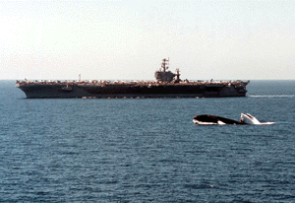
Nuclear Option (Continued)
Gender: Open to both men and women.
Educational Requirements: SAT/ACT waived for Nuclear applicants. Applicants must have finished sufficient undergraduate work to complete requirements for a baccalaureate degree in 36 months.
Medical Standards: All STA-21(N) candidates must meet the physical qualification requirements for submarines and nuclear field duty.
Service Obligation: STA-21(N) selectees incur a five-year active duty obligation upon commissioning.
10

Slide 11
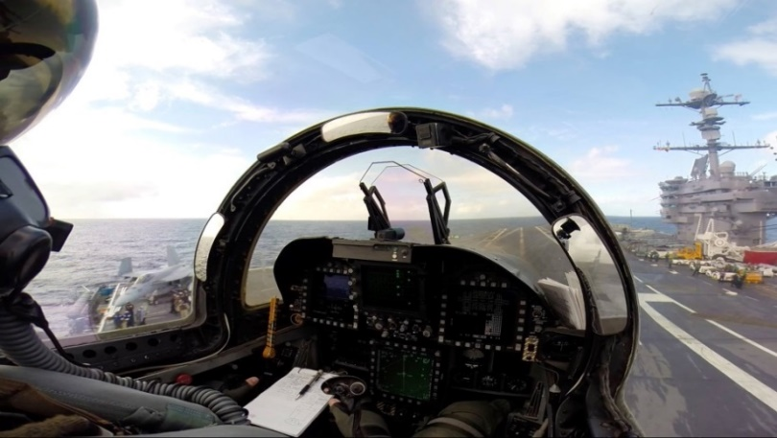
Pilot Option
Able to complete degree requirements and be commissioned by age 32.
Available for active duty Navy enlisted personnel of all ratings.
Achieve a score of Academic Qualification Rating/AQR(4) and Pilot Flight Aptitude Rating/PFR(5) on the Aviation Selection Test Battery/ASTB.
POC for ASTB: (850) 452-2379 or NMOTC-ASTB@med.navy.mil
Must pass Student Naval Aviator flight physical exam, prior to application, to ensure that applicants are fit for aviation duty.
Incur an eight year active duty obligation upon date of designation as a Naval Aviator or six years from date of disenrollment from flight training unless released by the Deputy Chief of Naval Operations (Manpower and Personnel).
11

Slide 12
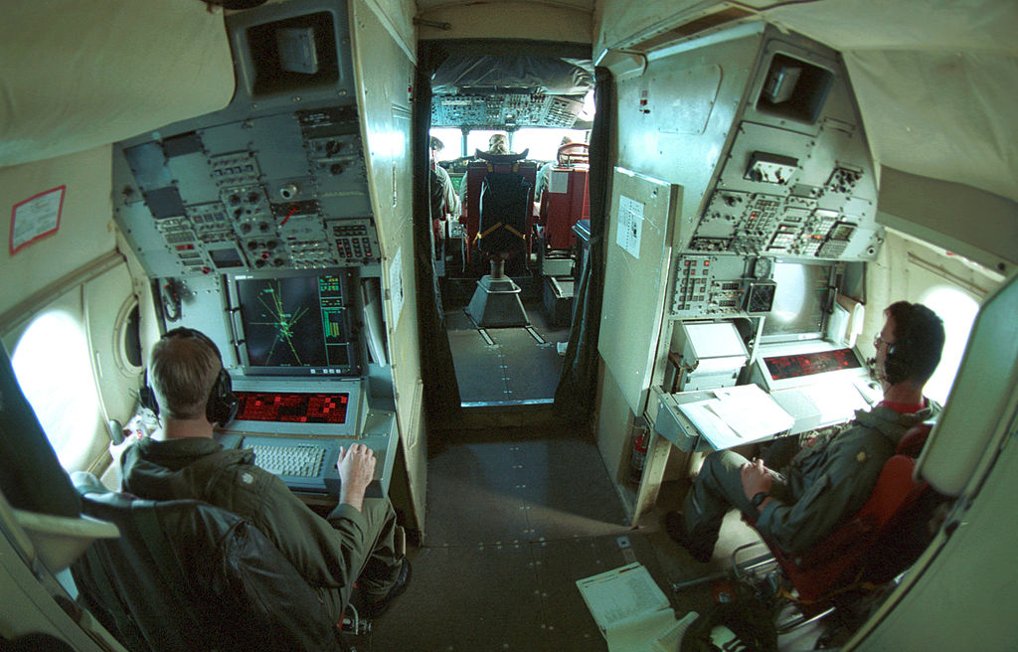
NFO Option
Able to complete degree requirements and be commissioned prior to 32nd birthday.
Available for active duty Navy enlisted personnel of all ratings.
Achieve a passing score of AQR(4) and FOFAR(5) on the ASTB for 1370 applicants. Must pass Student Naval Flight Officer flight physical exam, prior to application, to ensure that applicants are fit for aviation duty.
STA-21 NFO Option officer candidates will incur a six year active duty obligation upon date of designation as a Naval Flight Officer or six years from date of disenrollment from flight training.
12

Slide 13

SWO Option
Able to complete degree requirements and be commissioned prior to 35th birthday. No Waiver!
Available for active duty Navy enlisted personnel of all ratings.
To commission, must meet medical standards in accordance with the Medical Manual, Chapter 15.
STA-21 SWO Option selectees will incur a five year active duty
obligation upon commissioning.
13

Slide 14

CEC Option
Able to complete degree requirements and be commissioned prior to 42nd birthday.
Have sufficient college credits to complete ABET engineering degree or NAAB architecture degree within 36 months.
Must maintain a 2.7 minimum grade point average on a 4.0 scale. Preferred degrees are civil, mechanical, ocean and electrical engineering.
Open to all ratings. Selectees must have at least four years of active duty (of which at least three years were in an other than formal training environment as of the scheduled start of Naval Science Institute (NSI) for year applying.).
Medically qualified (Same as Core Program with exception that color vision deficiency is not disqualifying).
Incur a 5-year active duty obligation upon commissioning.
www.npc.navy.mil/Officer/BUPERS-316E/CivilEngineerCorps
14

Slide 15

SPECWAR (SEAL) Option
Must be at least 19 years old, able to complete degree requirements, and not have passed their 42nd birthday at the time of commissioning.
Must pass physical qualification IAW Medical Manual, Chapter 15, including qualification for Special Operations Duty.
Incur five-year active duty obligation upon commissioning.
Applicants must carry the O26A or O23A NEC and not have begun their LPO milestone.
Contact SEAL OCM at SEAL_OCM@navy.mil for required package components.
Open to both males and females.
15

Slide 16

Explosive Ordnance Disposal (EOD)
Selectees must be at least 19 years old and must be able to complete degree requirements and be commissioned prior to 35th birthday. No waivers are available for this program.
Open to active duty Navy enlisted personnel.
Applicants must have one of the following enlisted EOD NECs: M02A, M03A, M04A, M1DV, M2DV, B16A, B17A, L27A, or L28A.
Must pass physical qualification in accordance with the Medical Manual, Chapter 15, including qualification for diving duty and/or combat swimmer.
Incur five-year active duty obligation upon commissioning.
16

Slide 17

Nurse Corps Option
Must be at least 18 years old. Must complete degree requirements and be commissioned prior to 42nd birthday.
Available for active duty Navy enlisted personnel of all ratings.
Exempt from the Calculus and Physics requirement of STA-21 Core program.
  Must meet math/science requirements of Nursing degree program.
Must have completed a minimum of 45 quarter, or 30 semester credit hours in undergraduate nursing prerequisite courses; Psychology, Biology, Chemistry, Organic Chemistry, Anatomy and Physiology, Microbiology, Nutrition, Sociology, History, General English and Math.
Available only at specially identified NROTC affiliated colleges or universities with nursing programs that confer a Baccalaureate Degree in Nursing that is accredited by the NLNAC or the CCNE.
Must meet licensure requirements.
Selectees will incur a five-year active duty obligation.
17

Slide 18
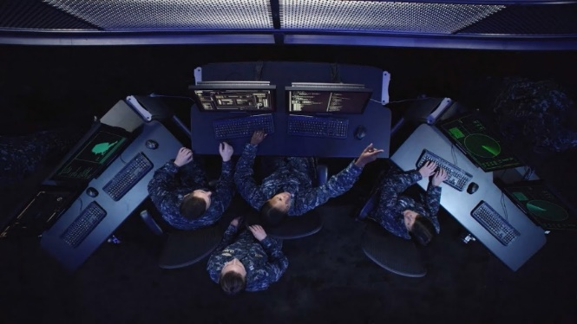
Information Professional Option
Must be at least 18 years old and be able to complete the degree requirements and be commissioned prior to 42nd birthday. No waivers will be considered.
This option is open to men and women of all ratings.
Participants must maintain a cumulative 3.0 or higher GPA on a 4.0 scale.
Must pass physical standards in accordance with the Medical Manual, Chapter 15 – color blindness not disqualifying.
Applicants who are selected, must have a current TS/SCI clearance or provide proof that TS/SCI documentation has been submitted.
Applicants are required to pursue fields of study directly related to science technology, engineering and mathematics.
Incur a 5 year active duty obligation upon commissioning.
18

Slide 19

STA-21 Program Application
Part 1 On-Line Application:
    https://netfocus.netc.navy.mil/Gateway/sso.aspx
    Statistical Data
    Check Application Status
    Update Application
Part 2 Mail-In Portion:
    Naval Service Training Command
    Attn: N92/STA-21
    320A Dewey Ave Building 3, Room 106
    Great Lakes, IL 60088-2845
    Preferred method of delivery is
    through mail. If mail delivery is
    not possible, contact N92 at
    grlk_sta21(at)us.navy.mil for
    alternative delivery methods.
19

Slide 20
STA-21 Program Application (Continued)
Applicant’s Responsibility:
  Application cover letter
  Personal statement – signed and dated
  Evals (last 5) – front and back
  SAT/ACT scores
  ASTB (Pilot or NFO only)
  High school transcripts or GED.
  College Transcript(s) – if applicable. In order to receive credit for an Associates Degree, it must be documented on a College Transcript.
  Additional documents (NEC, qualifications, awards, page 4s, etc.).
  Current PFA/PRT result printed from PRIMS – or CO statement
  Nuclear personnel only – an approved NAVPERS 1306/7 by OPNAV (N133), and detailer (Pers-403), is required for all Nuclear trained personnel who are applying for non-nuclear Officer commissioning programs.
  Page 13 Statement of Understanding for Primary Option and CORE* (*if secondary option is applicable)
20
Notes:
Cover letter-use website cover letter. Correspondence manual may help with formatting. (SECNAVINST 5216.5D)
10 or 12 font-one page only
Personal statement should include request for waiver of any type. Statement should be about why you want to be a Naval Officer.
5 evals-no holes. NOB submit. Remember to copy the back!
SAT/ACT scores MUST be in the package! Updated scores can be forwarded after app in but original scores must be in packet.
Qualifying ASTB scores for Pilot and NFO MUST be in the package!
Transcripts-front and back, certified true copies (for all enclosures). Transcripts required not Diploma.
Transcripts can be sent to student and opened at command for certification (they do not need to be sent directly to us).
Pictures for nukes only. Page 13 for Primary & Secondary if applying for both.
PFAs (3) via PRIMS printout. Failure within a year of application is disqualifying.
If downloading pages from website, please remove headers and footers.
Utilize check sheet to ensure you have sent all documents. Your application represents you to the board. Be thorough and be early.
Be prepared for your interview. Know your goals, why you chose the option you did, COC, current events, how you will handle responsibility and decisions etc. Look sharp, hair, uniform, shoes, posture, (women, hair, nails, earrings). Be respectful, make eye contact and try not to reflect anxiety/nerves. Even if you know the board, remember you are interviewing for a job-don’t be overly familiar.
Don’t waste time and money by using fancy folders or document protectors. Use bulldog clip not staples and send in plain large envelope. Remember to keep a copy for your records!!! We will not return applications.
Once the applicant turns the package in to the command, they should not see it again. The command will take over from here!

Slide 21
STA-21 Program Application (Continued)
Command’s Responsibility:
  CO Endorsement letter with ranking- signed and dated
  CO Recommendation Form
  Interview board appraisal sheets (3) – CO does not submit one.
Nomination Review Board’s Responsibility:
  NRB Chairperson Recommendation Form
  Interview board appraisal sheets (3) – NRD Chair does not submit one.
  Interview Verification Form – signed and dated by both Commanding Officers
21
Notes:
CO’s endorsement
If waiver requested, CO should comment on it.
If Command wants you to do rough endorsement, DO IT! And don’t be shy or humble!
If Command doesn’t fulfill their responsibilities, you won’t be penalized. Stay up to date using the application status portion of the web site.
Ensure one rep from chosen option on board. All 03 and above.
In ranking, consider how rank will help or hurt based on comparative group. Will you rank all candidates or like groups of candidates.
Does the CO recommendation match the evaluations recommendations?
Nom boards
must be justified in the CO’s endorsement if not done
Nom Chairman doesn’t have to be senior to CO, but must not be in the chain of command (i.e., not subordinate to the CO)
Chairman can be member of board (1 of 3 or 1 of 4). Ensure designators and job titles are on sheets for 03 or above.

Slide 22
STA-21 Program Application (Continued)
*Application Deadline*
  Applications must be post-marked NLT than 1 July.
  Those applications received missing information listed or postmarked later than the due date will not be eligible for the Selection Board. Extenuating circumstances will be considered on a case by case basis and should be addressed in CO’s endorsement.
22
Notes:
All applications from one Command can be mailed together but is not required.
Package must be complete AT THE TIME IT IS MAILED! If not complete by 1 July you are ineligible.
Must meet basic requirements by 1 July but if additional data will help you after 1 July- you may mail/fax/email updates (ex: new higher test scores). Call us to ensure receipt.

Slide 23
STA-21 Program Application
(Screening Procedures)
Check applicants age compared to the Option in which they are applying.
Don’t forward packages that lack CO’s recommendation.
Address discrepancies in application (i.e. missing statement(s) of understanding, lack of HS and/or college transcripts, missing interviewer’s appraisal sheets, eval gaps, prior scholarship attempts, copies of awards or anything that is not readable).
23
Notes:
All applications from one Command can be mailed together but is not required.
Package must be complete AT THE TIME IT IS MAILED! If not complete by 1 July you are ineligible.
Must meet basic requirements by 1 July but if additional data will help you after 1 July- you may mail/fax/email updates (ex: new higher test scores). Call us to ensure receipt.

Slide 24
Selection Board Emphasis
OFFICER POTENTIAL
Fleet performance
Leadership
Willingness to assume responsibility
Advancement record
Officer comments
Physical fitness
ACADEMIC POTENTIAL
High School Transcript
College Transcript
AA/AS Degree
SAT/ACT Scores
24
Notes:
Board is 1-2 weeks long. Each record is reviewed by a minimum of 3 senior naval officers with at least one of the same designator as the option choice.
Many of board members are COs and XOs themselves.
Board process reviews every record (even those determined not qualified) for quality assurance. Then in the process the cream of the crop float to the top, the less competitive to the bottom and the hard to sort to the crunch. Crunch records are often most likely reviewed again by up to 5 members. It is like swimming competitions where the difference can be as small as a thousandth of a point.
The board is concerned with the “WHOLE” person concept!

Slide 25
Selection Board Comments
Most important part of package is CO endorsement (consistency, comments, leadership experience).
Try to get more senior people to conduct external Interview boards. (Specific community applicant is applying to should be represented).
Applicant’s personal statement should explain any weaknesses or special circumstances (deployment, poor HS grades, etc.). Must specify option(s) applying for and why.
Gain as much off duty education as possible prior to applying.
Technical Courses/Degrees hold a lot of weight with the board. (Shows an ability to complete Calculus/Physics)
Applicants should gain recommendations outside of their COC. (Past CO’s, CMC’s, HS coaches, etc.)
Sailors selected as alternates should state this status in package when reapplying.
25

Slide 26
Trends
Early completion - Do you have college credits and/or your AA/AS?
Service over self
PFA - Do better than the minimum; STA-21 program standard is good/low or better.
Average selectee SAT: 1200+
College credits - Calculus, Physics, College Algebra etc., math is important!
College grades - 2.50 GPA or higher, shows an ability to complete college coursework. The more rigorous the curriculum and the higher the GPA, the more you will stand out.
Whole Person - community involvement, outside activities.
26
Notes:
Whole person – for junior personnel remember to include High school activities

Slide 27
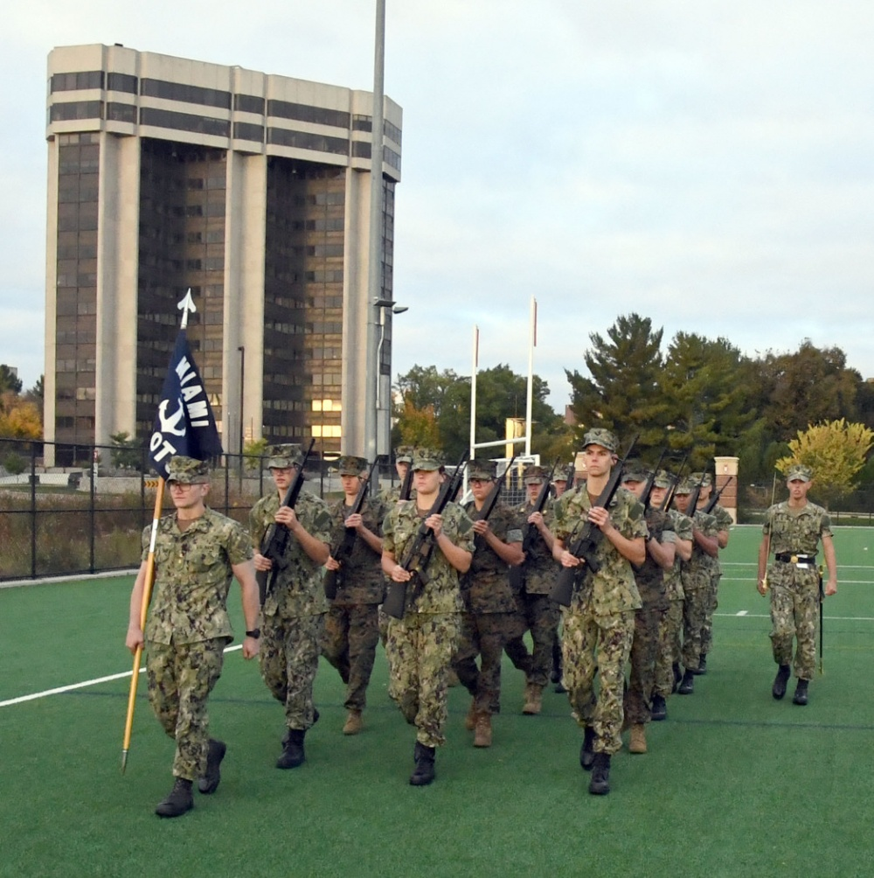


STA-21 Education Paths
SELECTION
NSI
College
Commissioning

Slide 28

Seaman to Admiral-21
At the University…
  Assigned to an NROTC unit as an Officer Candidate.
  Remain on active duty…receive pay and allowances. Time does not count towards officer retirement but it does count for pay purposes.
  Complete degree program within 36 months and prior
  to age limit for assigned option.
  Complete two semesters of calculus and calculus-based physics. (Exception: Nurse Option.)
  Attend unit established drills, labs,
  GMT, etc.
  Maintain all eligibility requirements
  Service Selection (Core option only.)3
28
Notes:
Once in the program – you must maintain all eligibility requirements.
GOOD LOW – PFA
2.5 GPA
2.0 in Calculus and Physics (each semester)
No alcohol incidents
Poor judgment – no NJPs

Slide 29
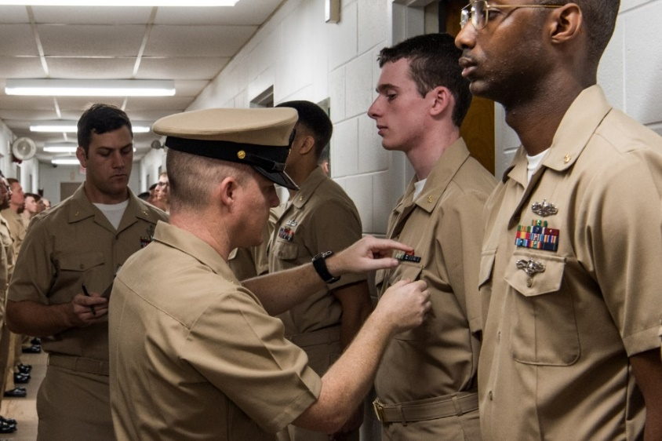
Naval Science Institute - OTC Newport
Two six week courses starting in February and March
Covers Professional Military Education:
  Introduction, Sea Power and Maritime Affairs
  Naval Sea Systems I and II (Engineering and Weapons)
  Navigation and Naval Ops
Physical Readiness Training
Swimming Qualifications
Receive Officer Candidate uniforms
29
Notes:
Once in the program – you must maintain all eligibility requirements.
GOOD LOW – PFA
2.5 GPA
2.0 in Calculus and Physics (each semester)
No alcohol incidents
Poor judgment – no NJPs

Slide 30
STA-21 Milestones
Application Opens Feb 2025
Application Deadline 1 Jul
Selection Board Aug/Sep
NAVADMIN of Selectees Oct
Begin NSI Feb/Mar 2026
Begin College* Sum/Fall
* Not all participants will begin at same time
30

Slide 31
STA-21 Information
Commercial: (847) 688-5454x242 or 243
DSN: 792-5454x243 or 242
Email: GRLK_STA21@us.navy.mil
Website: https://www.netc.navy.mil/Commands/Naval-Service-Training-Command/STA-21/
31

