Slide 1
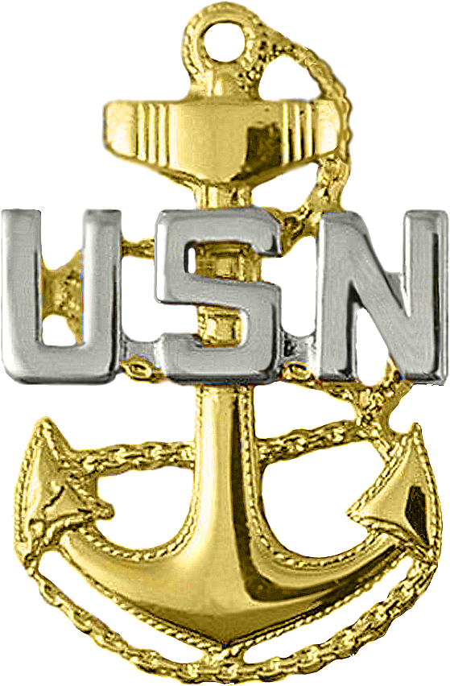

Warrior Toughness
Introduction for CPO’s
Notes:
Introduce yourself and your role in training toughness to CPO’s

Slide 2
Introduction
  Warrior Toughness is a mind, body, soul toughness initiative that establishes use of a warrior mindset, the Navy’s core attributes, and performance psychology skills to enhance performance and warfighting readiness.
  Toughness and the Warrior mindset will be enculturated through training in our accession pipelines and re-enforcement throughout the Sailor’s career.
Notes:
Warrior Toughness is here to stay. It’s not a program, it’s not a GMT, it’s the way of the Sailor, and it’s the way of the Chief.

Slide 3
Why Warrior Toughness (WT)?
Fleet missions and Sailor’s daily routines require toughness and a warrior mentality
Proven method to increase human performance
Metrics from accession training, BUDs and other WT pilots programs demonstrated success
  RTC, NNPTC, SUBFOR 10
Notes:
Although these techniques are already well established to be effective at enhancing performance with athletes and in other branches of the military, RTC tested them to make sure they were still effective in the Navy. The applied exercises portion of WT was tested through a series of IRB-approved research studies. Across all studies, applied exercises led to an increase in “on-time” graduation rates with the Recruits’ first assigned division. This equates to decreased time-to train and associated training/personnel costs. Applied exercises also led to improved performance on baseline PFA, swim qualification, and inspections.
They have received numerous reports from staff and recruits about the positive impact of Warrior Toughness. Recruits who have gone through the holistic, WT training (character development and applied exercises) consistently espouse and display a sense of belonging/connectedness and increased commitment to our organization. This training must be reinforced from the mess across the fleet. We have the power to make sure our Sailors use these tools and use them as warfighters and as a way of life.

Slide 4
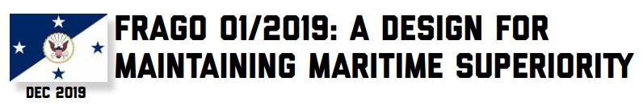
A Call to Arms
The current security environment demands that the Navy be prepared at all levels for decentralized operations, guided by commander’s intent. This operating style is reliant on clear understanding up, down, and across the chain of command. It is also underpinned by trust and confidence created by demonstrating character and competence. Our actions must always reflect our core values of Honor, Courage, and Commitment. Four Core Attributes define our professional identity and serve as guiding criteria for our decisions and actions. Leaders at all levels must continue to educate and focus our Sailors through example, education, and dialogue.
Notes:
Have a member of the Mess or a CPO Selectee read the information
In 2019, CNO Adm. Richardson discussed the importance of displaying our core values of Honor, Courage, and Commitment through four core attributes.
ASK: What are the Four core attributes of a United States Sailor?
(Integrity – Accountability – Initiative – Toughness)
Your commitment to our values will be demonstrated by how you live your life. In the navy, a person of character will live out the core attributes.
Ask: How will you, as a Chief, take ownership of your values? How can you turn this into example, education, and dialogue?

Slide 5
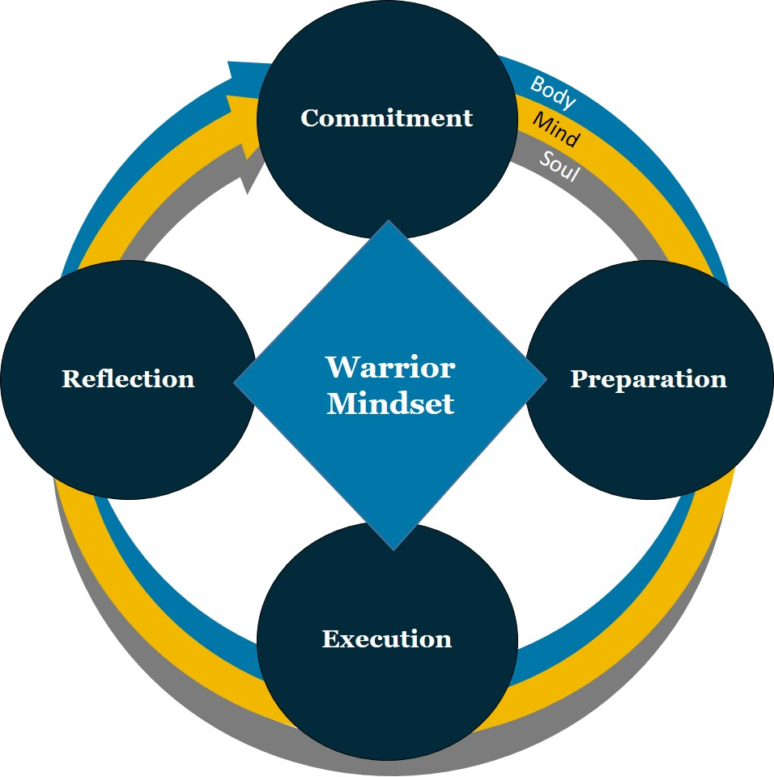
Warrior Mindset
How do you achieve and maintain Warrior Toughness?
A cycle of excellence.
Notes:
This is a cycle of excellence that we use to reach our best ever performance.
This is a recurring cycle that begins with commitment. As leaders, we need to determine how our values as individuals integrate into the Navy Core Values. This will help us to enable the same process with our subordinates. As leaders, we need to think about these values, where they come from and why they are important. Just by asking ourselves these questions, we facilitate an opportunity for growth and give us a foundation from which to make decisions on in difficult times.
ASK: How can we expect to do our theoretical best if we are not aligned and committed?
Commitment requires both discipline and motivation.
ASK: What are you committed to? What is the mess committed to?
The cycle continues with preparation. We must prepare for known and unknown difficulties. The warriors approach to mental preparation and enduring focus is derived from: a strong sense of commitment and purpose, and is continued by discipline and training.
The discipline and training is the preparation. It ensures that when we fall back on the training or preparation, it is sound enough to get us through that combat or high-stakes situation. No one rises to the occasion, we fail to the level of our training.
The warrior prepares the body, mind, and soul.
The next part of the cycle is Execution. We execute our tasks mindfully, being fully engaged in the moment.
Distractions lead to complacency that costs money and lives. This is where all of your preparation and commitment comes into play. Even when we are performing our daily operational tasks, we must be prepared to flex when the situation changes and things go off script.
It is in these moments that we must ensure that we do not get hijacked emotionally by the situation. We must maintain our situational awareness, agility, and focus on the task without getting sucked in.
Being mindful during execution, having present moment awareness is crucial to mission accomplishment. We should not think about the future or the past, only what is in front of us in the moment.
The last phase of the Warrior Mindset is reflection. This is a disciplined post event procedure. There are two main types of reflection: individual and organizational. Individual is where we assess past performance and ask ourselves if our actions and words were congruent with our commitments. Organizational reflection is more defined and serves to promote improvement within that context.
This reflection on past performance allows us to reengage without commitments to ensure they still align without goal and personal philosophy. In this way, the warrior Mindset is a continuous cycle of improvement that we utilize over and over again in order to achieve our best-ever performance.
Post-event reflection is where we are able to grow. If we do not reflect, we cannot improve. Period.

Slide 6
“Myths” vs. “Reality”
Myth – Resilience is Toughness.
Reality – Resilience is a component of and a required element of toughness. A base level of resilience is required for toughness.
Myth – Toughness is about mental health.
Reality – Toughness is focused on increasing performance BEFORE, DURING and AFTER stressors/critical events.
Notes:
We have all heard of the words “toughness” and “resilience.” We want to distinguish these two terms because they are often confused and are actually two different concepts.
Resilience (and resilience programs) focus on prevention of negative outcomes after stressors/critical events (e.g. preventing self-destructive behaviors). Resilience focuses on recovery from adversity; reducing or preventing illness or injury in Sailors; getting them back to their individual baseline prior to the event.

Slide 7
“Myths” vs. “Reality” Continued
Myth – Mindfulness techniques don’t work because there’s no time to stop during a stressor/critical event to get yourself together.
Reality – Mindfulness techniques are designed to be practiced so that stopping is not required during a stressor/critical event so that one may continue to fight through. The mind can be trained and developed through these techniques.
Notes:
Toughness (and WT program) focuses on the mindset prior to a critical event with an emphasis on improved performance and ethical decision making as well as what happens after. Toughness focuses on performance enhancement in execution of the mission and making healthy sailors better at their job.

Slide 8
Core Attributes
Accountability
Initiative
Integrity
Toughness
  What do these mean to you as a CPO?
Notes:
The CNO defines accountability as aligning our collective behavior with our mission. If integrity is about self, accountability is about community. It’s a commitment to give of myself for the sake of those I am connected to. I am connected to a mission-focused force, we maintain high standards, we honestly assess our progress and adjust as required, and as leaders in command we recognize the unique trust and confidence placed in us to operate independently.
ASK: As Chiefs, what are we accountable to?
Traditionally, the definition of initiative has been pretty simple: find a job and do it. And while that is not a bad start, we all know that you can create plenty of problems by doing a job you have no place doing. The definition of initiative that comes from the design for maintaining maritime superiority is very helpful.
ASK: Why do you think Initiative is important to a Chief?
Integrity is about aligning our behaviors to our values. Professionally, we share the common values of honor, courage, and commitment. These collective values unite us together as a team to accomplish the shared mission of defending the constitution. Our values align us as one as we defend freedom and democracy around the world. It is these values that keep our families safe and allow us to live out the American dream. They set for us our moral compass as Sailors, Chiefs and as an organization.
Toughness means that a warrior Sailor can take a hit and keep on going. How? By tapping all sources of strength, through rigorous training, a fighting spirit and the steadfast support of our families.

Slide 9
WT Competencies
Mind-Body Connection
Mindfulness
Body / Mental Scan
Self Talk
Mental Rehearsal
  Advanced WT techniques that need to be taught by trained instructors and rehearsed!
Notes:
First we need to understand how our brains were designed to survive in situations like running away from bears (fight or flight). So we have to be purposeful in how we train a part of our brain called the Frontal Cortex to respond differently in high pressure situations. This is why we do mindfulness exercises - to strengthen this part of the brain.
Mindfulness is being fully aware of the present moment, not just what’s going on around you (we call this situational awareness), but also what’s going on internally. What are you thinking, feeling – what is your body doing. With this awareness we can respond instead of react. In order to build mindfulness we need to do specific mindfulness exercises to grow the frontal cortex. While there are hundreds of mindfulness exercises out there, we include four in WT: Recalibrate, Progressive Muscle Relaxation, Body Scan, and Mental Scan. These exercises require the person to focus on something in the here and now and when their mind wanders off, refocus without getting frustrated with yourself. This is the mental version of push-ups – something you do ahead of time to build strength. Sailors should not be waiting until the moment of Execution to do a mindfulness exercise. Just like they shouldn’t drop and do push-ups in the middle of General Quarters.
Self-talk is the constant thinking that occur inside our minds. These thoughts can be distracting and not helpful, therefore impeding performance. Recruits are taught how to improve their self-talk and write Performance Statements to realign thoughts to be more focused and helpful.
Mental rehearsal is a performance psychology technique of rehearsing in your mind, the exact steps necessary to complete a task. Mental rehearsal can apply to any physical activity (running, swimming, public speaking, reps and sets, inspections, etc.). When rehearsing something mentally, it should be vivid (using all senses) and controlled (only rehearsing what you want to happen).

Slide 10
WT Competencies
How have you used these performance psych skills in your personal or professional life?
As a Chief, where might they be helpful in your division or department? How could you encourage rehearsal of these techniques?
Notes:
Were all a part of the Mess for a reason- we are high performers. Many of us do these things already. How have you used these performance psych skills before, and just didn’t call it by the names we are now?
As a Chief, how will these be helpful in your division or department? How could you encourage rehearsal of these techniques?

Slide 11
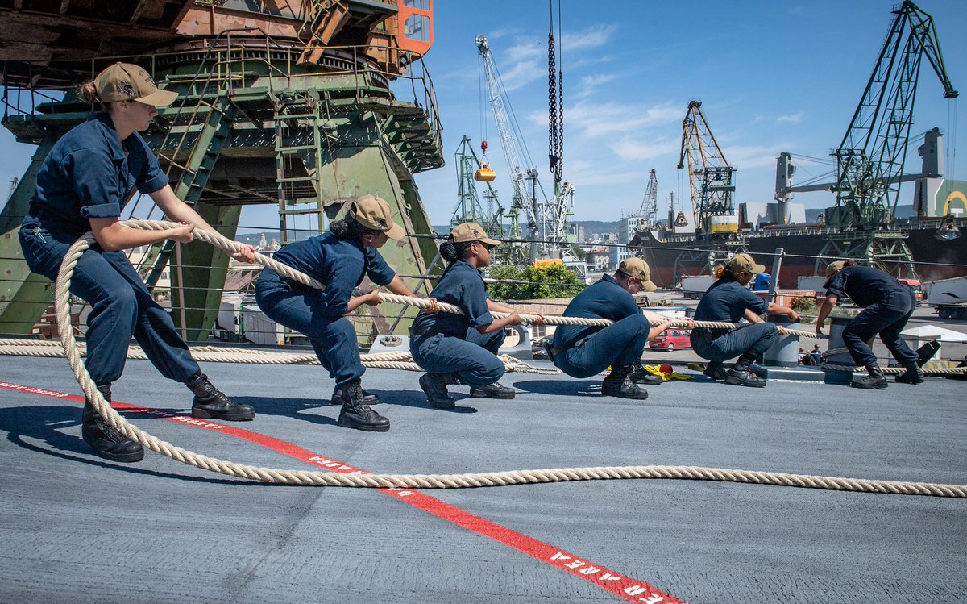
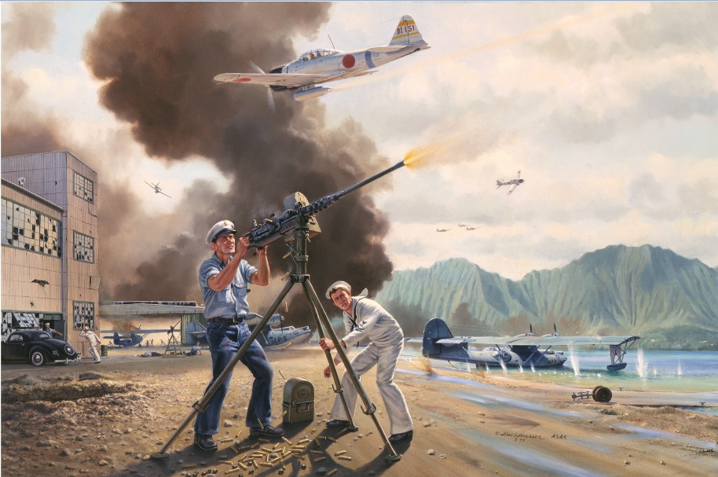
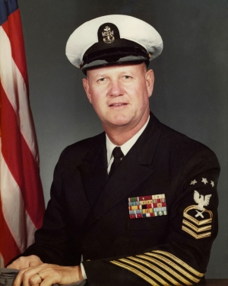
Toughness Defined - The ability to:
Take a hit and keep fighting.
Perform under pressure.
Excel in the day-in and day-out grind.
Notes:
Read slide, then move to next slide and ask questions to follow

Slide 12
As a Chief,
you will have to show your ability to:
Take a hit and keep fighting
  What have you experienced?
Perform under pressure
  What are some examples you see your Sailors facing?
Excel in the day-in and day-out grind
  How do you see WT techniques helping?
Notes:
When have you taken a hit in your career? Were you able to keep going right after? What did that look like?
You’ll be performing under pressure during Initiation. What skills will you use to commit, prepare, execute and reflect?
How do you see the WT techniques helping you excel in the day-in and day-out grind?

Slide 13
How is WT rolling out?
  USFFC is the Executive Agent through Culture of Excellence Campaign
  NETC Domain
    NSTC WT Center of Excellence / Model Manager
    Adding two training sites (San Diego and Norfolk) as Fleet Touchpoints
  Three sites will provide five day Advanced Toughness Instructor training for Learning Site and Fleet lead facilitators
  Baseline WT 101 course for all that did not receive during accession ( in development).

Slide 14
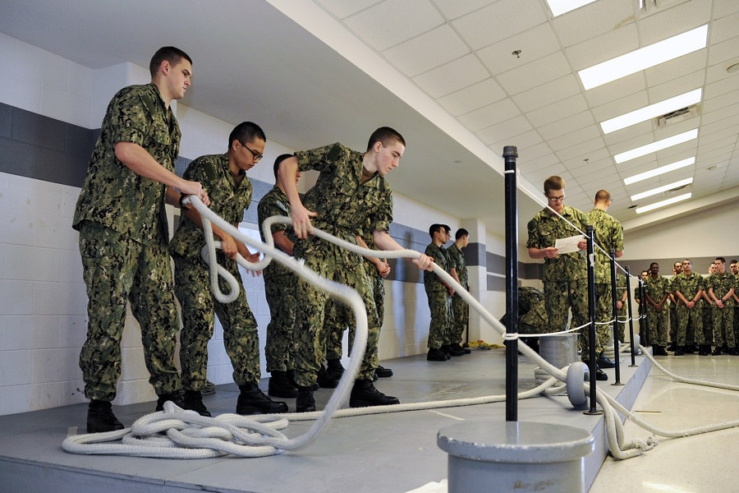
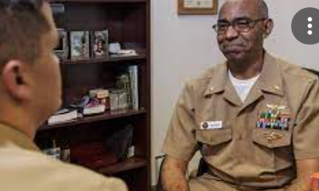
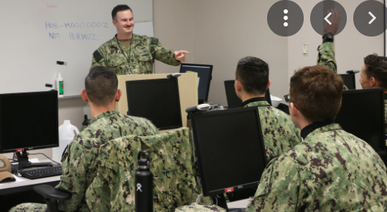
WT Instructional Hierarchy
Advanced Toughness Training Facilitator
Advanced Toughness Training curriculum designed to support:
1. Development of WT Instructor curriculums
2. Development of WT Student curriculums
3. Provide quality control
4. Provide formal training to WT Instructors
Course(s) received: NETC Instructor Rollout Training and Advanced Training Facilitator Course
WT Instructor
Warrior Toughness Instructor curriculum that provides a basic level of knowledge and experience in providing instruction on the skills and topics.
Course(s) received: NETC Instructor Sustainment Training (taught as part of the NITC course)
WT Student
Warrior Toughness Foundations curriculum given throughout accession training programs:
Requirement(s): 1 WT team (Clinical Psychologist (03/04), Chaplain (03/04), Warrior)
Requirement(s):Course taught by Advanced Toughness Training Facilitator
1. USNA: Basic course taught in Plebe summer, reinforced over 4 years
2. ROTC: Basic course taught in NSI, reinforced over 4 years
3. RTC/OTC: Basic course taught over accession program
4. Follow on A and C schools: Reinforcement of WT skills and concepts within current curriculum.
Requirement(s): Course taught by general WT Instructor
Warrior
Toughness
Culture
Incorporates Science of Learning
Notes:
The Science of Learning is an approach that recognizes the value and importance of cross-fertilization across traditional fields of study, drawing on many different methods and techniques to understand how learning occurs— with the ultimate goal of optimizing learning for all. John Hopkins Science of Learning Institute Web Page
The work NSTC (Naval Service Training Command) has done with Warrior Toughness has incorporated the Science of Learning as described above starting with the use of a multi-disciplinary instructor team. It is reinforced through practical skill development and application, and then further refined through a feedback loop between the Sailor and RDC.
This work reflects the 5 principles of learning: Participation, Repetition, Relevance, Transference and Feedback.
As you can see from the slide here there are three levels of training. The WT Student training is administered throughout the accession pipelines. The WT Instructor training allows instructors to deliver basic WT training, with the requirement of the Advanced Toughness Training Facilitator Course.
The Advanced toughness training facilitator course is designed to support the development of WT instructor and student curriculums, provide quality control, and provide formal training to WT instructors. These Facilitator teams must consist of subject matter experts: clinical psychologists, chaplains, and warrior instructors.

Slide 15

Initial Fleet WT Rollout
Optimize Performance Through Toughness
Plan
Implement
Sustain
SEP | OCT | NOV | DEC | JAN | FEB | MAR | APR | MAY | JUN | JUL | AUG
NECC-L & 15 PAX CPF WT Training (@ NSTC)
(Pilot)
CNSP
WT Training
(San Diego)
CNAP & CNAL
WT Training
(San Diego)
CSP & NECC-P
WT Training
(San Diego)
CNSF & IFOR WT Implementation Complete
(CNSF & IFOR)
CNAF WT Implementation Complete
(CNAF)
CSF WT Implementation Complete
(CSF)
Navy WT Roll out
CNSL WT Training (Norfolk by NSTC)
(Pilot)
Navy WT Roll-Out Plan Finalized
(USFF)
RESFOR plan developed & integrated
MSC & BUMED
WT Training
(Norfolk)
TYCOM SUSTAINMENT / TRAINING
FLEET / NETC / NSTC coordination on supportability of WT roll out
CNIC plan developed & integrated
CSL &
IFOR WT Training (Norfolk)
PERS
WT Training (Norfolk)
MSC & BUMED
Implementation complete
(MSC & BUMED)
NECC & PERS WT Implementation complete
(NECC & PERS)
CNSL WT Implementation Complete
NETC Learning Center Instructors Attend AWTT
NETC WT SMEs for LCs (Norfolk/San Diego) train @ NSTC
WT Video and Curriculum Finalized (NETC)
NETC WT LC Sites Stood Up (commence training 8000 instructors)
SEA / NLEC (Newport) curriculum fully updated w/ WT concepts / skills
NETC WT Expansion
CPO Initiation WT Integration
E-OSC curriculum Integration w/ WT
Commence Chaplain Syllabus Integration
(CoC / NSTC)
Solidify requirements for POM submission
(NETC / CNP)
Supporting & Enabling Action
MCPON Leadership Symposium (WT brief)
PAO Roll-Out Plan Approved / begin execution
(CHINFO / CNP)
CPO Initiation WT delivery
WT curriculum integration with E-OSC
Milestone
Coordination
Decision Point
Review
Notes:
This slide provides us an outline for Fleet Forces implementation and sustainment plan for the next year.

Slide 16
Conclusion
WT improves our ability to perform at a higher level!
“Carrying forward the legacy of those who came before you will test you and will require all the wisdom and strength that brought you to this day. The demands placed on you will be tough. I have high expectations of our Chief Petty Officers, as do the Sailors you will serve and lead. But I am confident that you will meet this challenge with humility and determination.”
ADM Gilday 28 Jan 2021
Notes:
It’s time for reflection. What do we need to do in order to meet this challenge?
Use this time for reflection aimed at strengthening commitments to WT and figuring out what needs to be done to succeed.

Slide 17
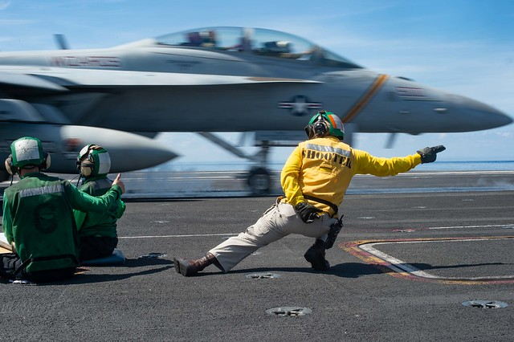
Questions?
Notes:
INDIAN OCEAN (March 7, 2019) Lt. Eric Jensen, from Austin, Texas, signals an EA-18G Growler assigned to Electronic Attack Squadron (VAQ) 133 to launch from the flight deck of the aircraft carrier USS John C. Stennis (CVN 74) in the Indian Ocean, March 7, 2019. John C. Stennis is deployed in the U.S. 7th Fleet area of operations in support of security and stability in the Indo-Pacific region. (U.S. Navy photo by Mass Communication Specialist Seaman Jeffery L. Southerland/Released) 190307-N-HS117-1206

